Slide 1

BANGALORE COLLEGE OF ENGINEERING AND TECHNOLOGY BANGALORE-560 099
DEPARTMENT OF ECE
MINI PROJECT
"SMART WASTE MANAGEMENT SYSTEM : AUTOMATED SEGREGATION AND REAL-TIME MONITORING”
PRESENTED BY
NARESH . N
TEJAS.M.S
SUDARSHAN.R
DEEPAK.R
DEPARTMENT OF ECE
PROJECT GUIDE
Mrs.KARTHIKA .V
HOD
DEPARTMENT OF ECE

Slide 2
OVERVIEW
Abstract
Introduction
Overview
Literature Survey
Algorithm & Architecture
Components
Implementation
Results
Future Scope
Conclusion
References

Slide 3
ABSTRACT
Development of a smart, automated waste management system.
Addresses inefficiencies in current waste segregation methods.
Utilizes automation and real-time monitoring for better management.
Implements Arduino, sensors, and IoT for accurate segregation.
Improves efficiency, reduces manual labor, and promotes sustainability.

Slide 4
INTRODUCTION
Growing urbanization leads to increased waste generation, requiring efficient management solutions.
Traditional waste segregation methods are labor-intensive and prone to errors.
Integration of smart technologies like IoT and automation for waste management.
To design a system that enhances accuracy and efficiency in waste segregation.
Aims to contribute to environmental sustainability and reduce operational costs in waste management.

Slide 5
OBJECTIVES
Centralized Control : The Arduino Uno acts as the central controller, processing input from various sensors and peripherals to automate waste management tasks.
Sensor Integration : Ultrasonic sensors measure the fill levels of waste bins, while a soil moisture sensor detects liquid waste.
User Interface : An LCD display provides real-time information on the system’s status and waste levels, ensuring users are informed about the bin conditions.
Status Indicators : LEDs and a buzzer serve as visual and auditory indicators, alerting users to important events like full bins or errors, thereby improving the system’s responsiveness and user interaction.

Slide 6
LITERATURE SURVEY
Prof. Pranali G. Chavhan, Ms. Vijayshri Nitin Khedka ,"Automatic Waste Segregator Based on IoT & ML Using Keras model and Streamlit" , IEEE 2023
Description:
Discusses the development of a creative waste management approach driven by global environmental sustainability concerns.
Aims to automate garbage segregation to increase recycling rates and reduce landfill pressure.
Advantages:
Enhances recycling rates and reduces landfill burden by automating garbage segregation.
Disadvantages:
Dependency on technology may introduce vulnerabilities to system failures or cyber attacks.

Slide 7
Cont…
Gopal Kirshna Shyam,Sunilkumar S. Manvi , "Smart Waste Management using Internet-of-Things" , IEEE 2017
Description:
Focuses on IoT's role in enhancing city functionality, particularly in waste management.
Introduces a waste management solution prototype based on IoT sensors for dynamic waste collection.
Advantages:
Increased efficiency through optimized collection routes and schedules.
Improved safety by identifying hazards like overflowing bins.
Disadvantages:
Privacy concerns regarding data collection and usage.
High implementation costs for IoT infrastructure.

Slide 8
Cont…
Dr.N.Sathish Kumar, B.Vijayalakshmi , "IOT Based Smart Garbage alert system using Arduino UNO" , IEEE 2016.
Description:
Addresses the global issue of waste management, particularly the problem of overflowing garbage bins in public places.
Describes the proposed system's components, including ultrasonic sensors, Arduino UNO, RFID tags, and IoT facilitation.
Advantages:
Enhances efficiency by automating the garbage clearance process and reducing manual monitoring.
Disadvantages:
Requires regular maintenance and calibration of sensors to ensure accurate garbage level detection.

Slide 9
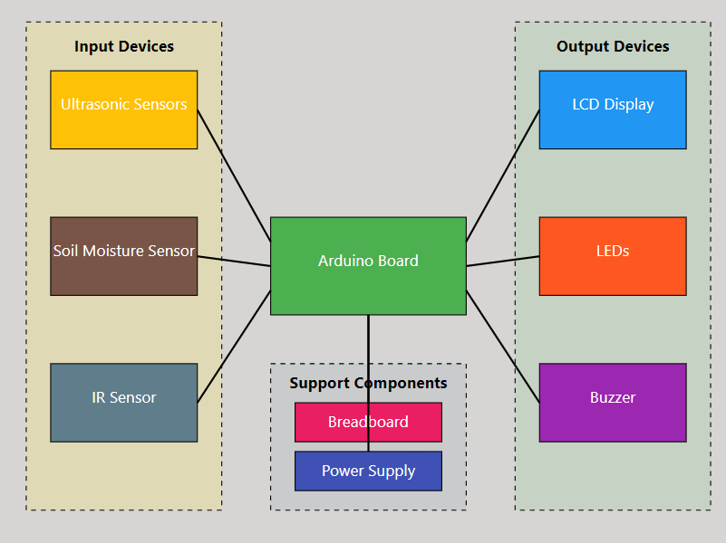
ALGORITHM & ARCHITECTURE
LCD DISPLAY
POWER SUPPLY
ARDUINO UNO
SERVO MOTOR 1
SERVO MOTOR 2
ULTRASONIC SENSOR 1
ULTRASONIC SENSOR 2
SOIL MOISTURE SENSOR
BUZZER

Slide 10
COMPONENTS
Arduino Uno
Ultrasonic Sensors
of waste bins.
LCD Display
LEDs
Buzzer
Soil Moisture Sensor
IR Sensor
Resistors & Jumper wires

Slide 11
IMPLEMENTATION
Waste is dumped
Marks the entry of waste
Segregation is done with the help of servo motor
Servo motor is rotated at lower speeds
Segregation is completed
Ultrasonic sensor is used to measure the level of trash
When the trash bin is full it alerts the user with the help of buzzer
Then the user makes the bin empty.

Slide 12
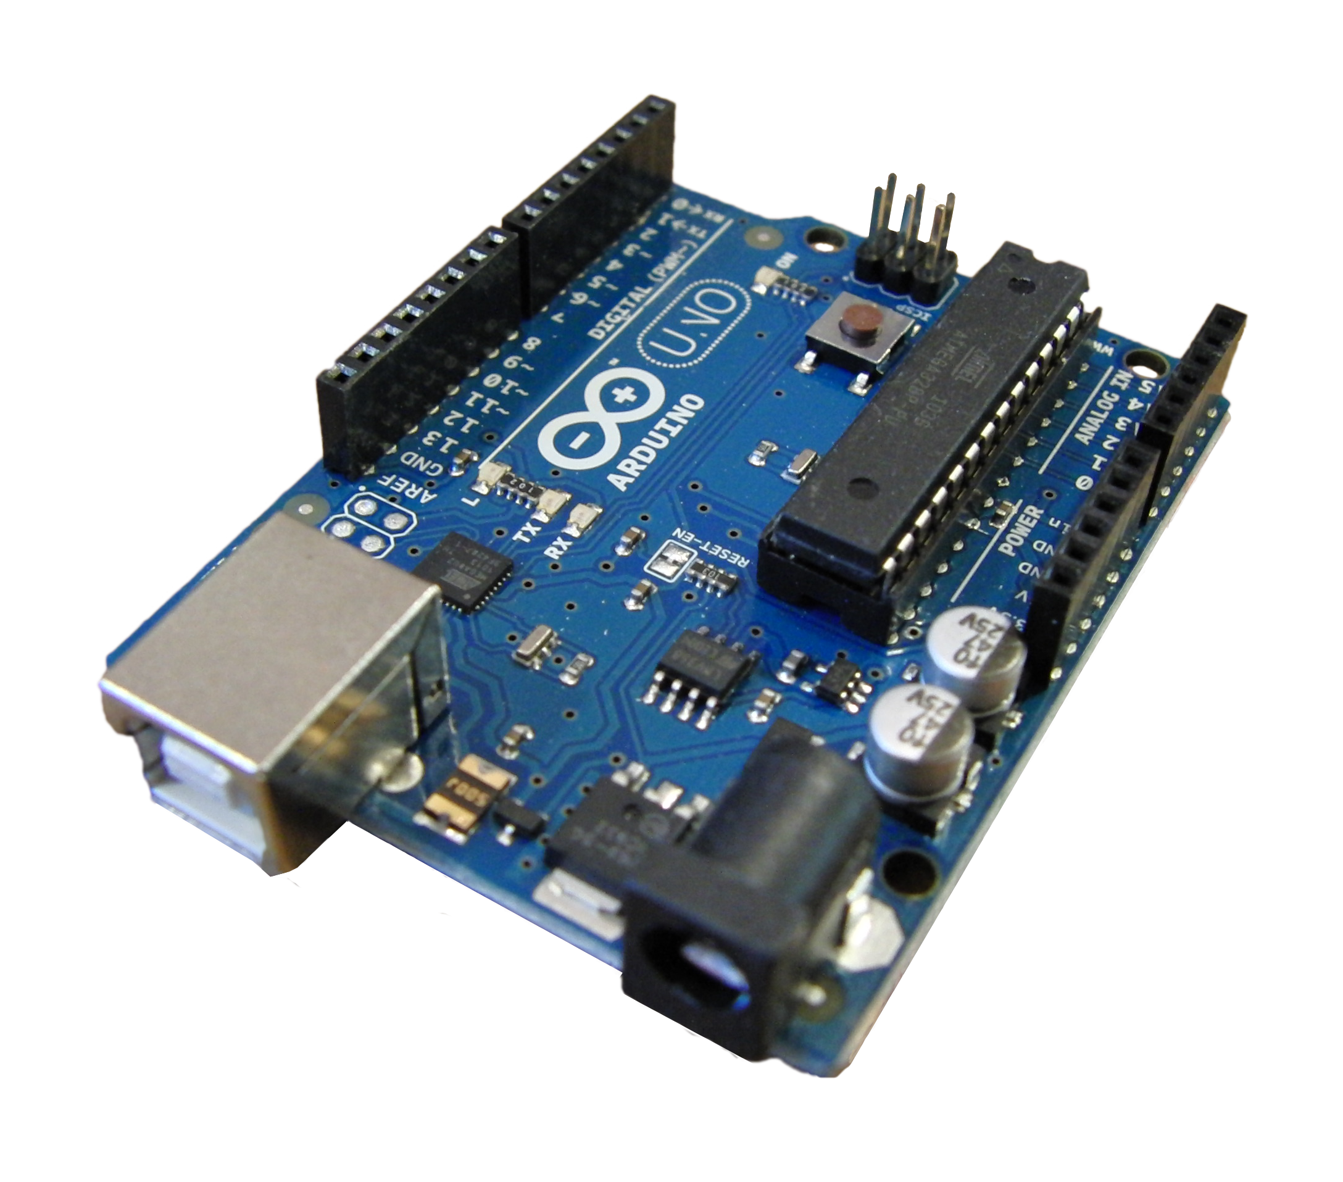
ARDUINO UNO
The Arduino Uno is a microcontroller board based on the ATmega328P.
Used for :
Sensor Data Processing
Display Control
Remote Interaction
Status Indication
System Coordination

Slide 13
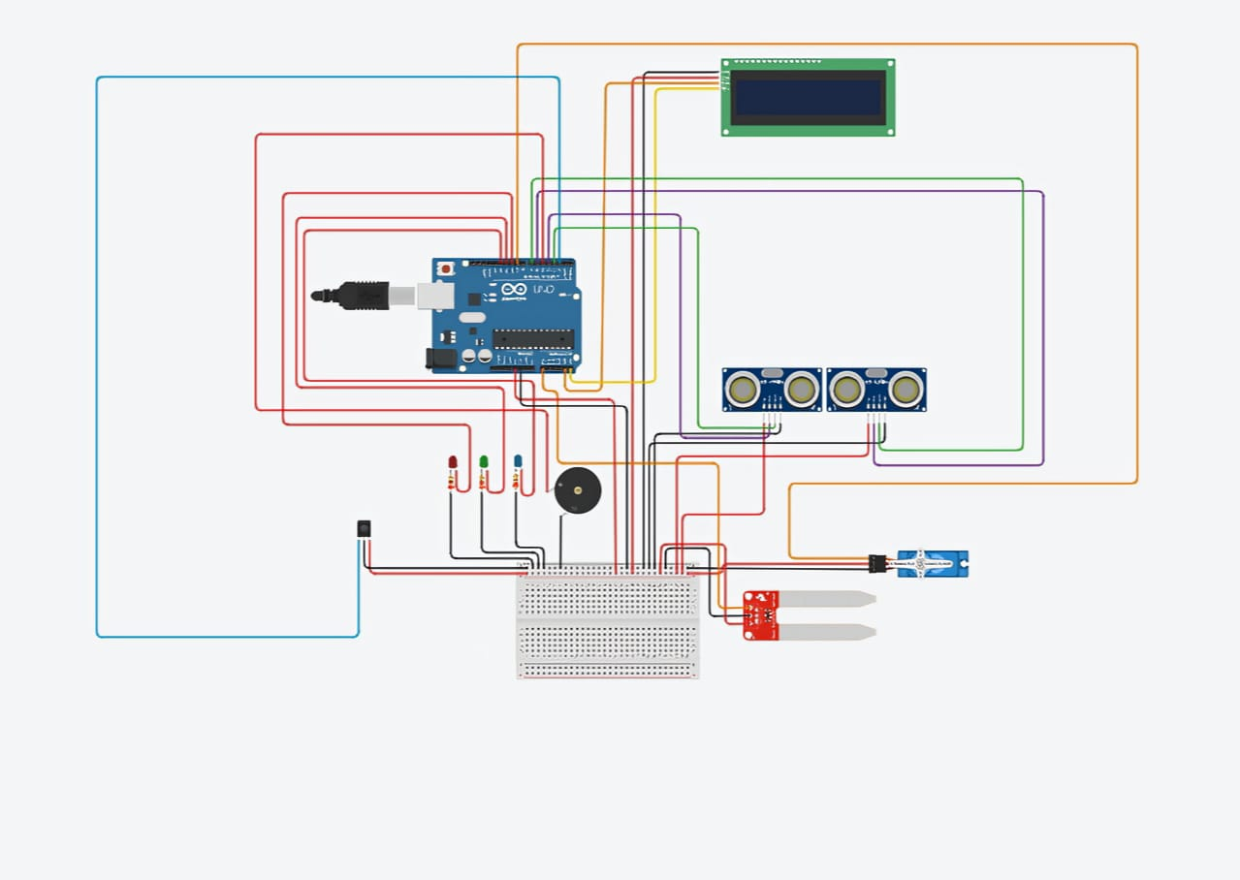

Slide 14
FUTURE SCOPE
Enhanced Automation : Future iterations can incorporate machine learning algorithms to predict and automate segregation processes more efficiently.
IoT Integration : By integrating with IoT networks, the system can provide real-time data to municipal authorities and waste management companies.
Scalability and Customization : The system can be scaled to manage waste in larger facilities like hospitals, schools, or industrial complexes.
Environmental Impact : With continuous improvements, the system can contribute significantly to environmental sustainability by reducing landfill waste, encouraging recycling, and managing hazardous waste more effectively.
Smart City Ecosystems : As part of a broader smart city initiative, the waste management system can integrate with other smart infrastructure (like water and energy management systems) to create sustainable urban environment.

Slide 15
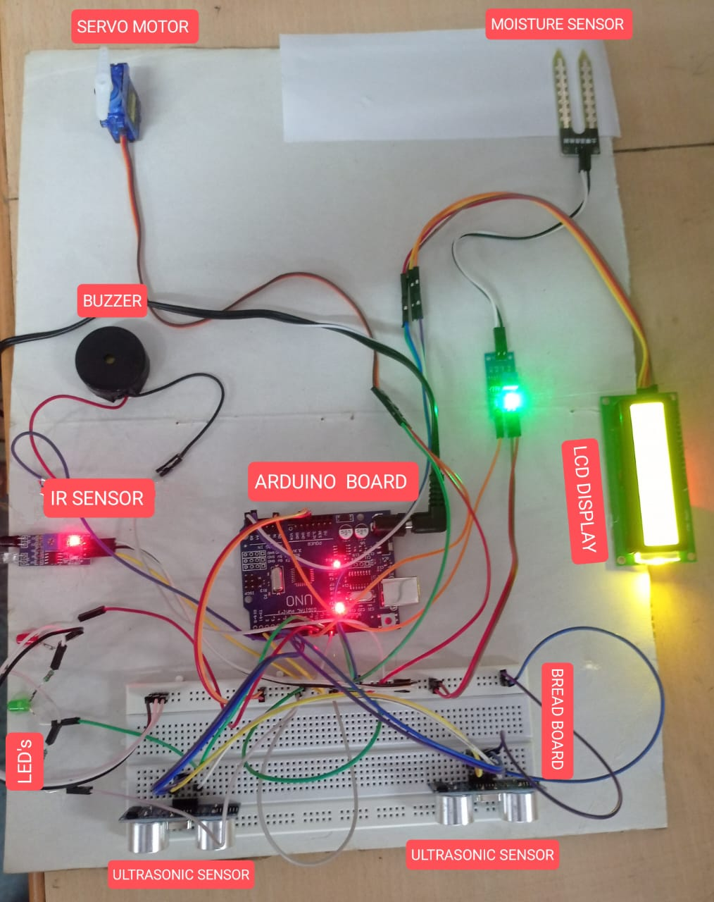
RESULTS

Slide 16
CONCLUSION
The project effectively integrates ultrasonic sensors, a soil moisture sensor, and an LCD display with the Arduino Uno to automate waste segregation and real-time monitoring.
The system improves waste collection efficiency by providing timely alerts for bin status, reducing manual labor, and promoting proper waste disposal practices.
Key challenges, including sensor calibration and system integration, were addressed, resulting in a reliable and accurate waste management system.
The project functionality enhances user interaction, making the system more convenient and easy to manage.
There is significant potential for future improvements, such as integrating machine learning for optimized operations and expanding IoT connectivity for better data analytics and urban waste management strategies.

Slide 17
REFERENCES
Prof. Pranali G. Chavhan, Ms. Vijayshri Nitin Khedka ,"Automatic Waste Segregator Based on IoT & ML Using Keras model and Streamlit" , IEEE 2023.
Gopal Kirshna Shyam,Sunilkumar S. Manvi , "Smart Waste Management using Internet-of-Things" , IEEE 2017 .
Dr.N.Sathish Kumar, B.Vijayalakshmi , "IOT Based Smart Garbage alert system using Arduino UNO" , IEEE 2016.
M.K.Pushpa, Aayushi Gupta, Shariq Mohammed Shaikh, Stuti Jha,Suchitra V, “Microcontroller based Automatic Waste Segregator”, IJIREEICE, Volume 3, Issue 5, May 2015.

Slide 18


